Slide 1
Data-Driven Discovery of Vehicle Dynamics Using Probabilistic Bayesian Neural Networks
Chinmay Samak Tanmay Samak Vasanth Seethapathi
csamak@clemson.edu tsamak@clemson.edu vasants@clemson.edu

Slide 2
Responsibility Assignment
Data Collection and Preprocessing:
Tanmay
Vasanth
Problem Formulation:
Chinmay
Tanmay
Implementation:
Tanmay
Chinmay
Hyperparameter Tuning and Pipeline Optimization:
Everyone
Note: Responsibility does not indicate contribution. We have no conflicts of interest to declare.

Slide 3
Motivation & Objective
Motivation:
Real-time multi-step dynamic simulation of complex multi-body models
Deep learning – learn implicit dynamics and generalize across multiple operating conditions
Bayesian inference – quantify uncertainty in model predictions for explainability & reliability
Objectives:
Forward simulation for state propagation
Replace hardware sensor by software model
State-estimation in coverage denied areas or in sensor malfunction conditions
Redundant variable measurement for more robust state-estimation
Predicting anomalies in sensor measurements and fault-tolerant control

Slide 4
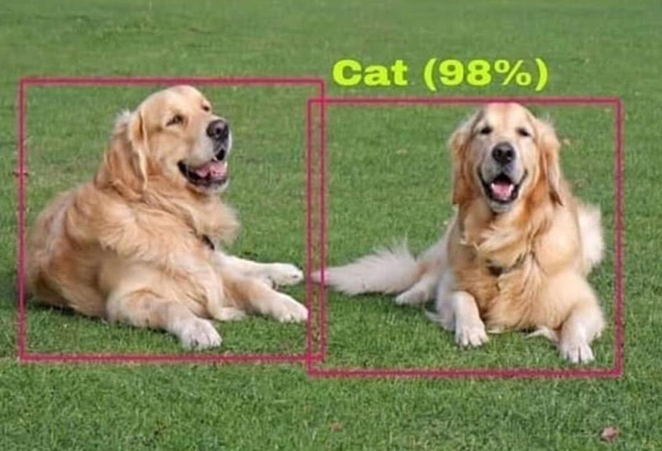
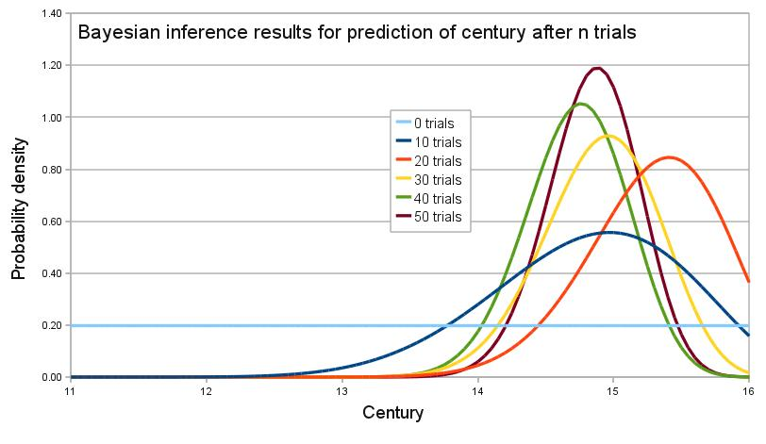
Introduction
Why Probabilistic Models:
Overconfident point-estimate models
Interpretability and explainability
Probability and Bayesian Inference:
Probability distributions and sampling
Start with a prior belief
Provide/sample new data
Update (variational) posterior belief
Source: Reddit
Source: Wikipedia

Slide 5
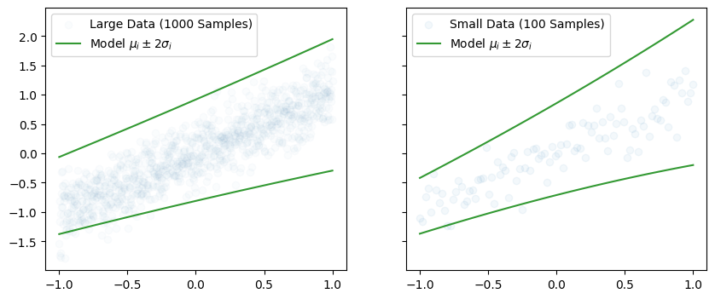
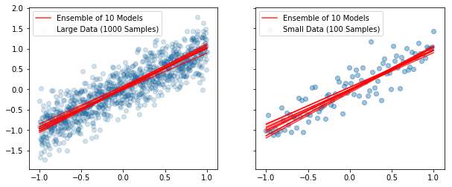
Uncertainty Quantification
Aleatoric Uncertainty
Homoscedastic
Heteroscedastic
Epistemic Uncertainty

Slide 6
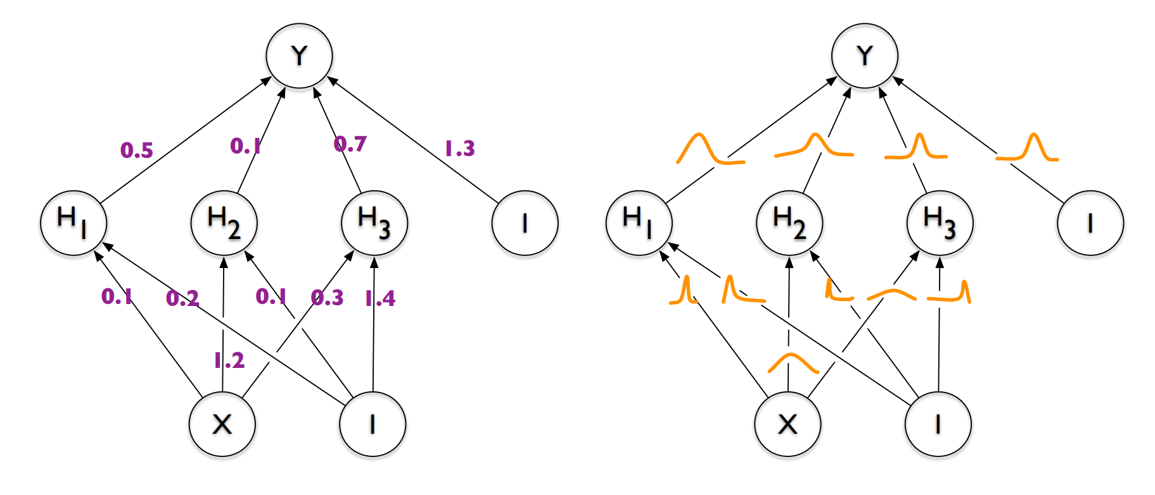
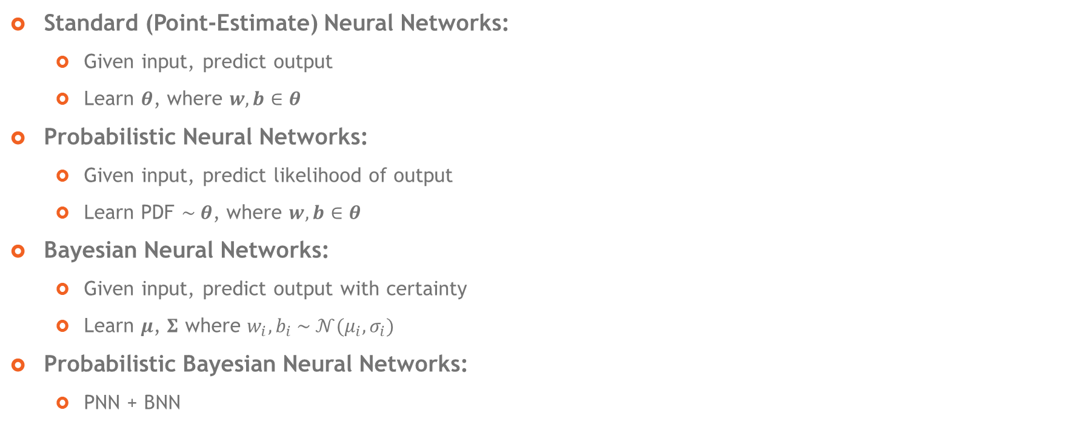
What is Probabilistic Deep Learning?
Standard (Point-Estimate) Neural Networks:
Given input, predict output
Learn $θ$, where $w, b∈θ$
Probabilistic Neural Networks:
Given input, predict likelihood of output
Learn PDF $\sim θ$, where $w, b∈θ$
Bayesian Neural Networks:
Given input, predict output with certainty
Learn $μ$, $Σ$ where $w_{i}, b_{i} \sim 𝒩(μ_{i},σ_{i})$
Probabilistic Bayesian Neural Networks:
PNN + BNN
Standard DNN
Bayesian DNN
Source: Charles, et al.

Slide 7
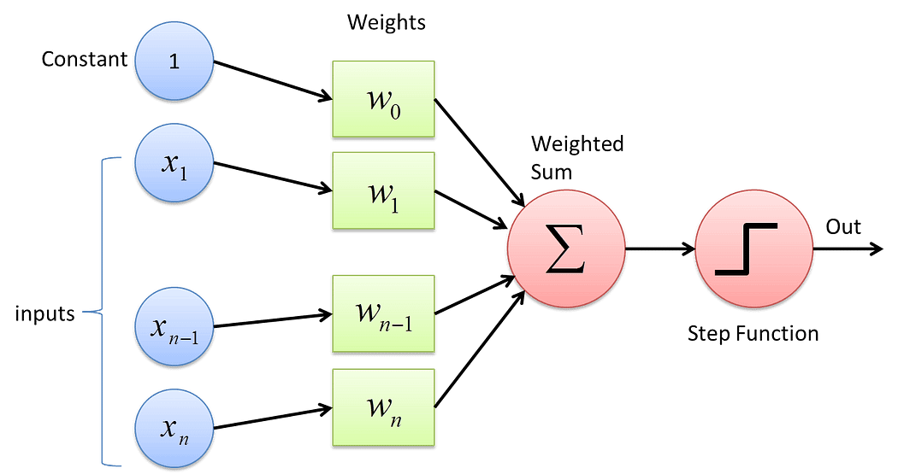
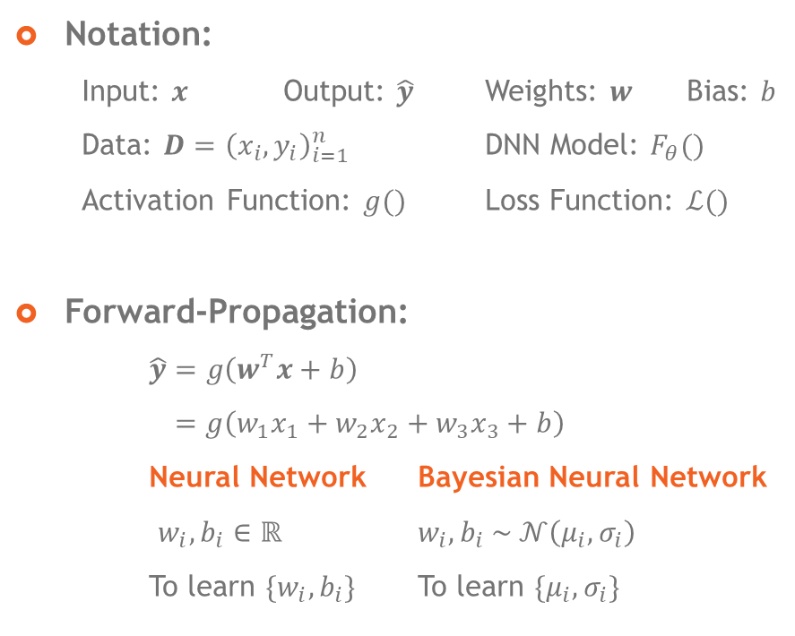
Mechanics of Bayesian Deep Learning
Notation:
Input: $x$ Output: $\hat{y}$ Weights: $w$ Bias: $b$
Data: $D={\left(x_{i}, y_{i}\right)}_{i=1}^{n}$ DNN Model: $F_{θ}()$
Activation Function: $g()$ Loss Function: $ℒ()$
Forward-Propagation:
$\hat{y}=g\left(w^{T}x+b\right)$
$=g\left(w_{1}x_{1}+w_{2}x_{2}+w_{3}x_{3}+b\right)$
Neural Network Bayesian Neural Network
$w_{i}, b_{i}∈ℝ$ $w_{i}, b_{i} \sim 𝒩\left(μ_{i},σ_{i}\right)$
To learn ${\{w}_{i}, b_{i}\}$ To learn $\{μ_{i}, σ_{i}\}$
Source: Sharma, TDS

Slide 8
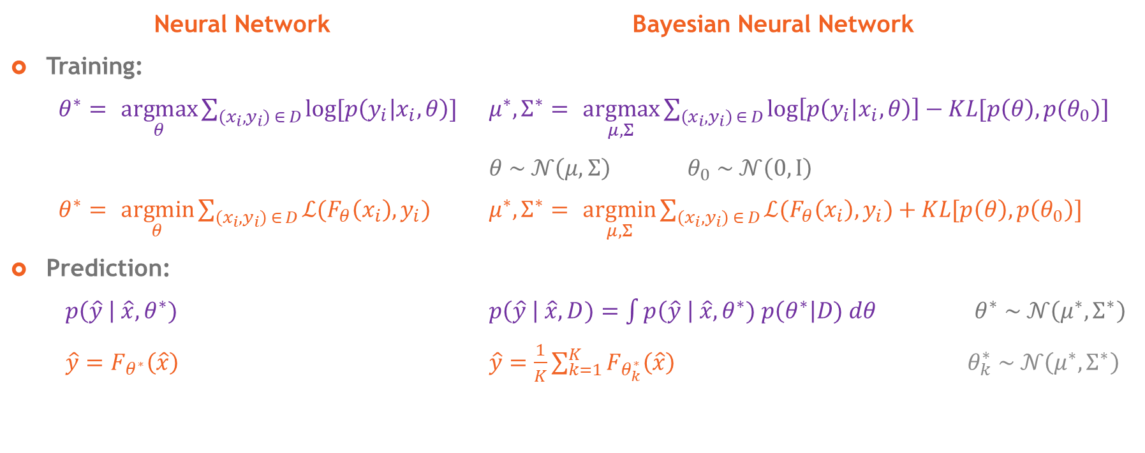
Mechanics of Bayesian Deep Learning
Neural Network Bayesian Neural Network
Training:
$θ^{∗}= \underset{θ}{argmax}{\sum_{\left(x_{i}, y_{i}\right) ∈ D}{log⁡[p\left(y_{i} | x_{i}, θ\right)]}}$ $μ^{∗}, Σ^{∗}= \underset{μ, Σ}{argmax}{\sum_{\left(x_{i}, y_{i}\right) ∈ D}{\log\left[p\left(y_{i} | x_{i}, θ\right)\right]−KL[p\left(θ\right), p(θ_{0})}]}$
$θ \sim 𝒩\left(μ,Σ\right)$ $θ_{0} \sim 𝒩\left(0,I\right)$
$θ^{∗}= \underset{θ}{argmin}{\sum_{\left(x_{i}, y_{i}\right) ∈ D}{ℒ(F_{θ}\left(x_{i}\right), y_{i})}}$ $μ^{∗}, Σ^{∗}= \underset{μ, Σ}{argmin}{\sum_{\left(x_{i}, y_{i}\right) ∈ D}{ℒ(F_{θ}\left(x_{i}\right), y_{i})}}+KL[p\left(θ\right), p\left(θ_{0}\right)]$
Prediction:
$p\left(\hat{y} \right| \hat{x},θ^{∗})$ $p\left(\hat{y} \right| \hat{x},D)=\int{p\left(\hat{y} \right| \hat{x},θ^{∗}) p\left(θ^{∗}\right|D) dθ}$ $θ^{∗} \sim 𝒩\left(μ^{∗},Σ^{∗}\right)$
$\hat{y}=F_{θ^{∗}}\left(\hat{x}\right)$ $\hat{y}=\frac{1}{K}\sum_{k=1}^{K}{F_{θ_{k}^{∗}}\left(\hat{x}\right)}$ $θ_{k}^{∗} \sim 𝒩\left(μ^{∗},Σ^{∗}\right)$

Slide 9
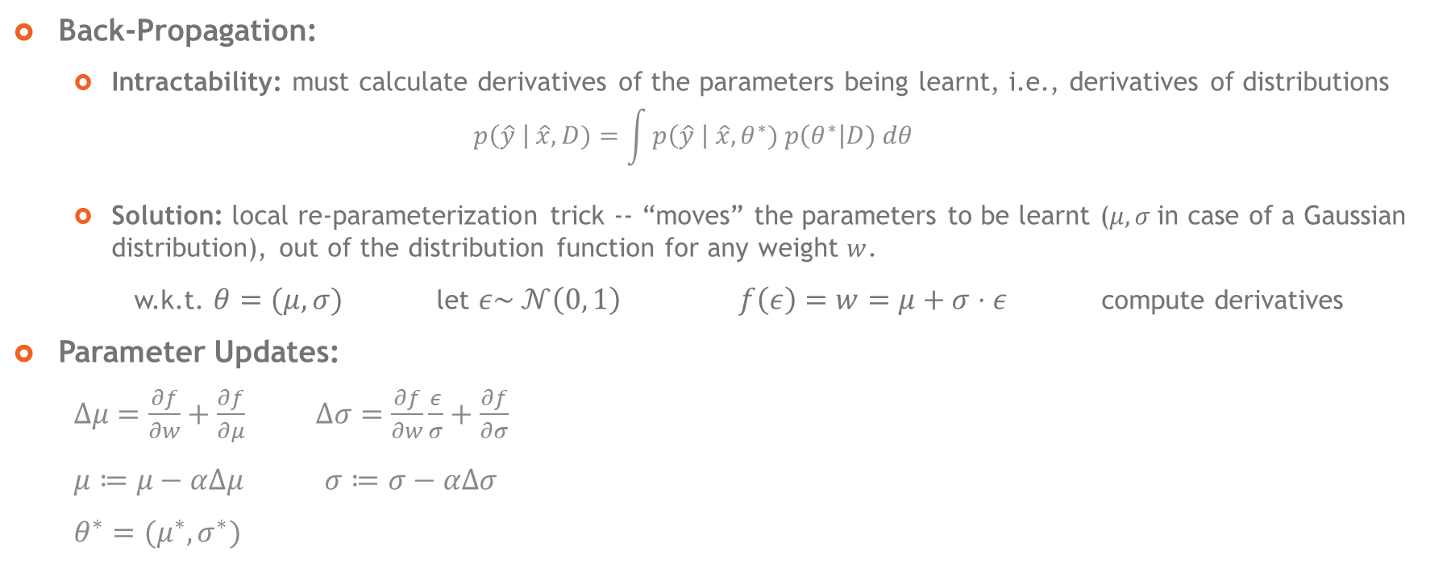
Mechanics of Bayesian Deep Learning
Back-Propagation:
Intractability: must calculate derivatives of the parameters being learnt, i.e., derivatives of distributions
$$p\left(\hat{y} \right| \hat{x},D)=\int{p\left(\hat{y} \right| \hat{x},θ^{∗}) p\left(θ^{∗}\right|D) dθ}$$
Solution: local re-parameterization trick -- “moves” the parameters to be learnt ($μ,σ$in case of a Gaussian distribution), out of the distribution function for any weight $w$.
w.k.t. $θ=(μ, σ)$ let $ε\sim 𝒩\left(0, 1\right)$ $f\left(ε\right)=w=μ+σ⋅ε$ compute derivatives
Parameter Updates:
$Δμ=\frac{∂f}{∂w}+\frac{∂f}{∂μ}$ $Δσ=\frac{∂f}{∂w}\frac{ε}{σ}+\frac{∂f}{∂σ}$
$μ≔μ−αΔμ$ $σ≔σ−αΔσ$
$θ^{∗}=(μ^{∗}, σ^{∗})$

Slide 10
Pros and Cons of Bayesian Deep Learning
Pros
They are more robust and generalizable
They can quantify the uncertainty in their predictive output
Cons
They can be more complicated to train (may require knowledge of probability and statistics)
They can be slower to converge and require more data (since the weights of the network are distributions instead of single values)

Slide 11
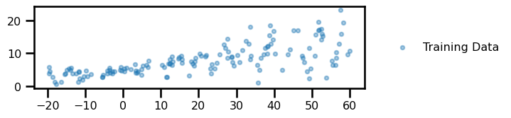
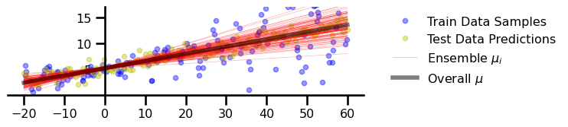
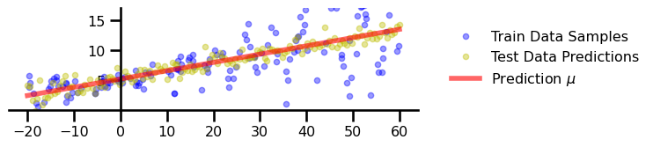
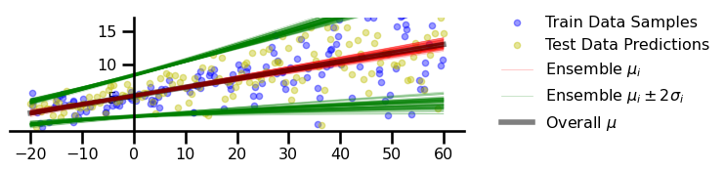
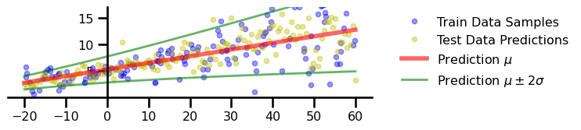
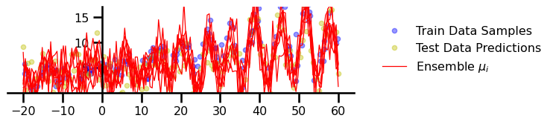
Preliminary Linear Regression Experiments
Data
Epistemic Uncertainty
No Uncertainty
Aleatoric + Epistemic Uncertainties
Aleatoric Uncertainty
Functional Uncertainty

Slide 12
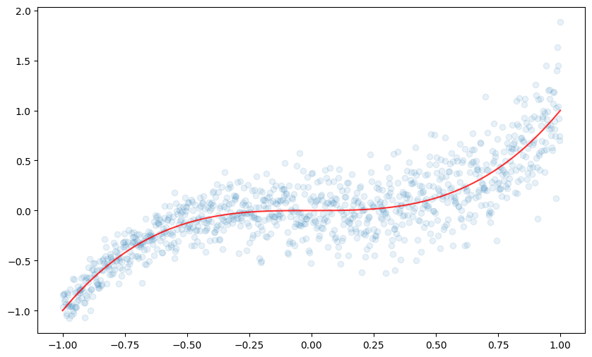
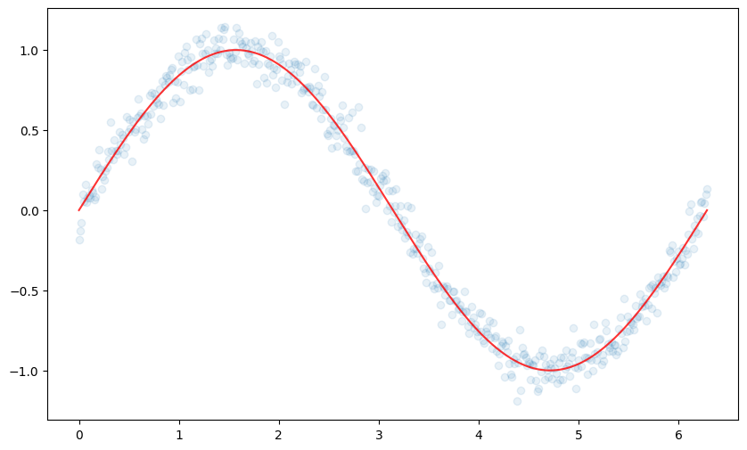
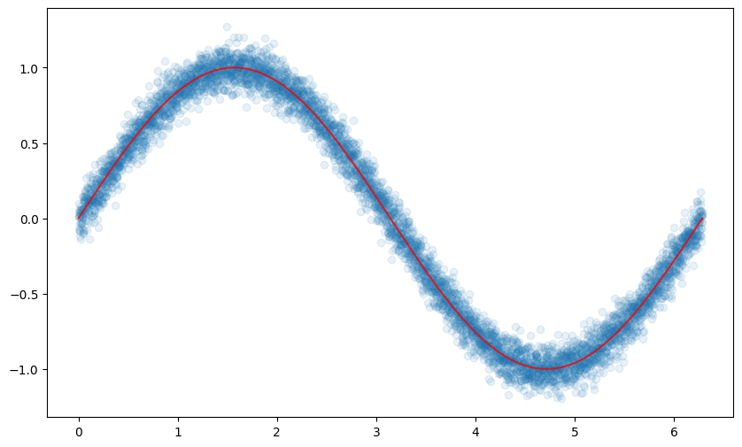
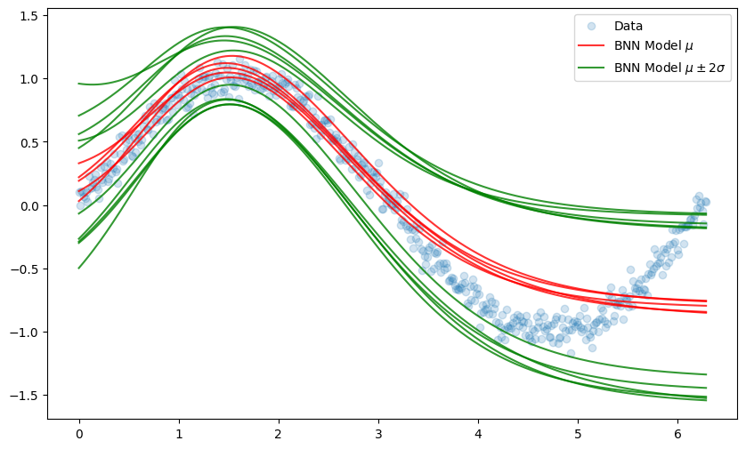
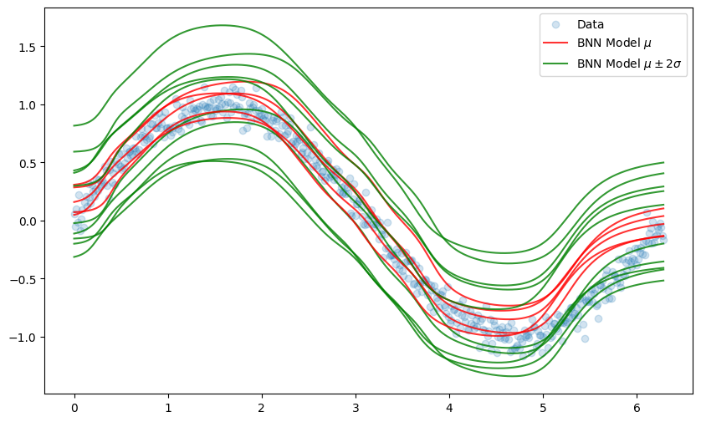
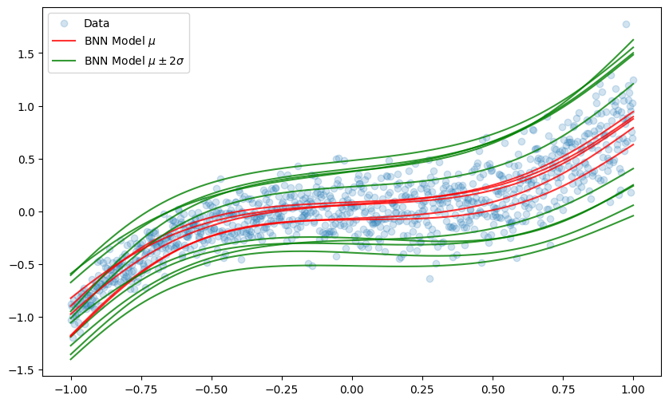
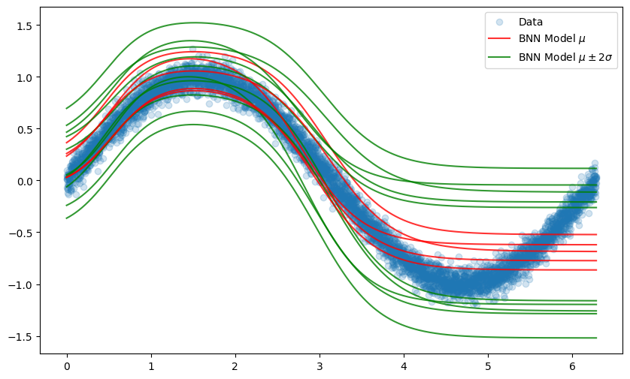
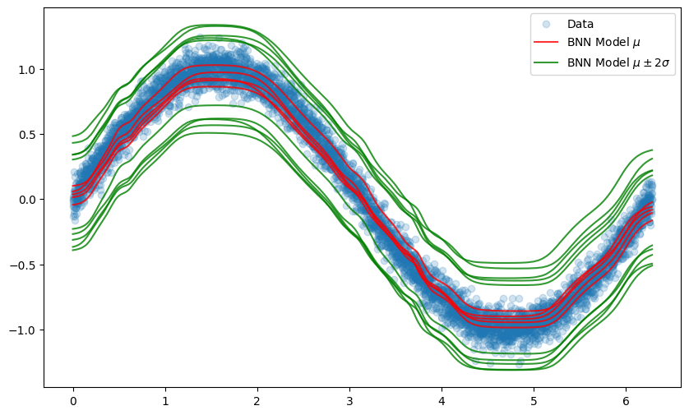
Preliminary Nonlinear Regression Experiments
Data
Data
Pure Model
Model Predictions
Hybrid Model
Cubic Data (1000 Samples)
Sinusoidal Data (500 Samples)
Sinusoidal Data (5000 Samples)

Slide 13
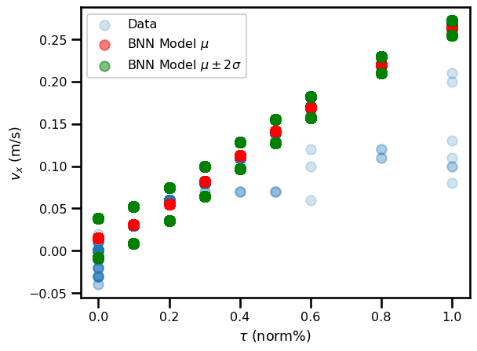
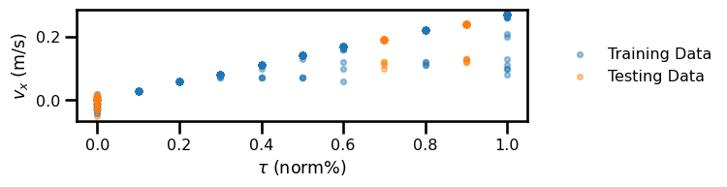
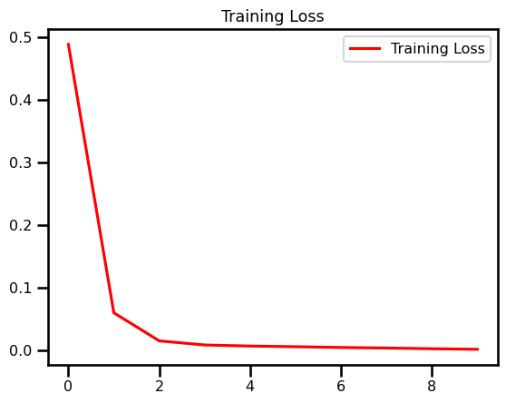
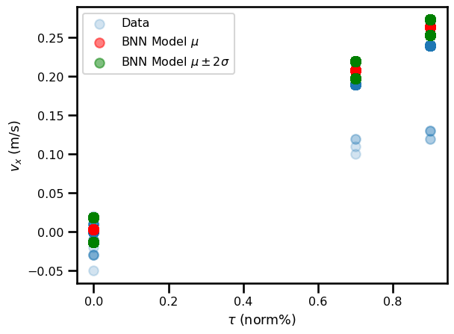
Preliminary 1D VD Experiments

Slide 14
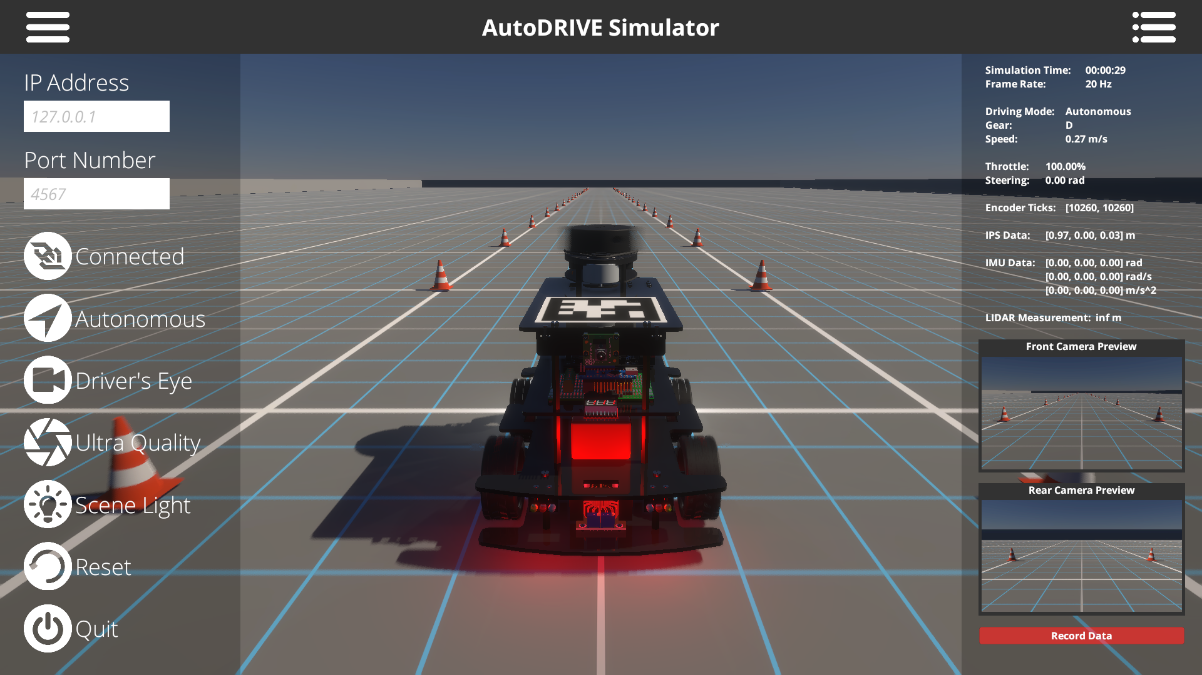
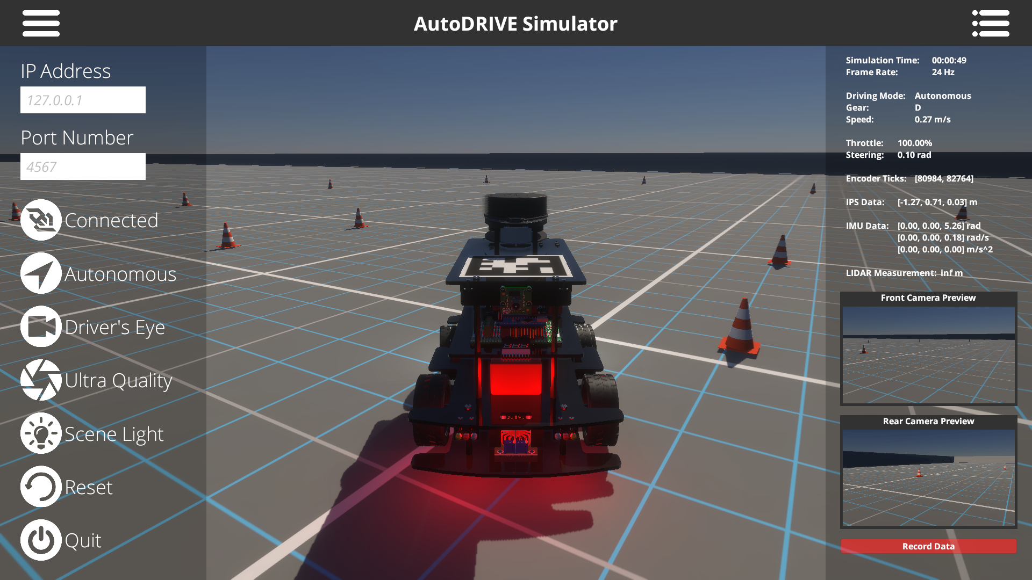

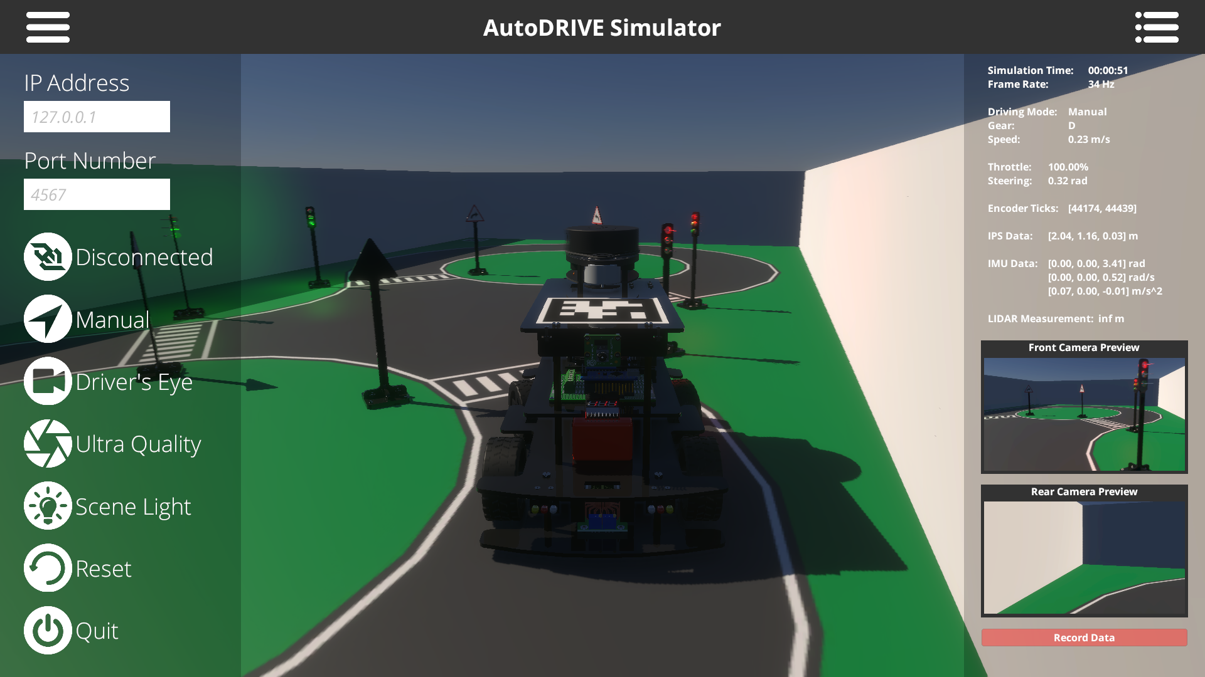
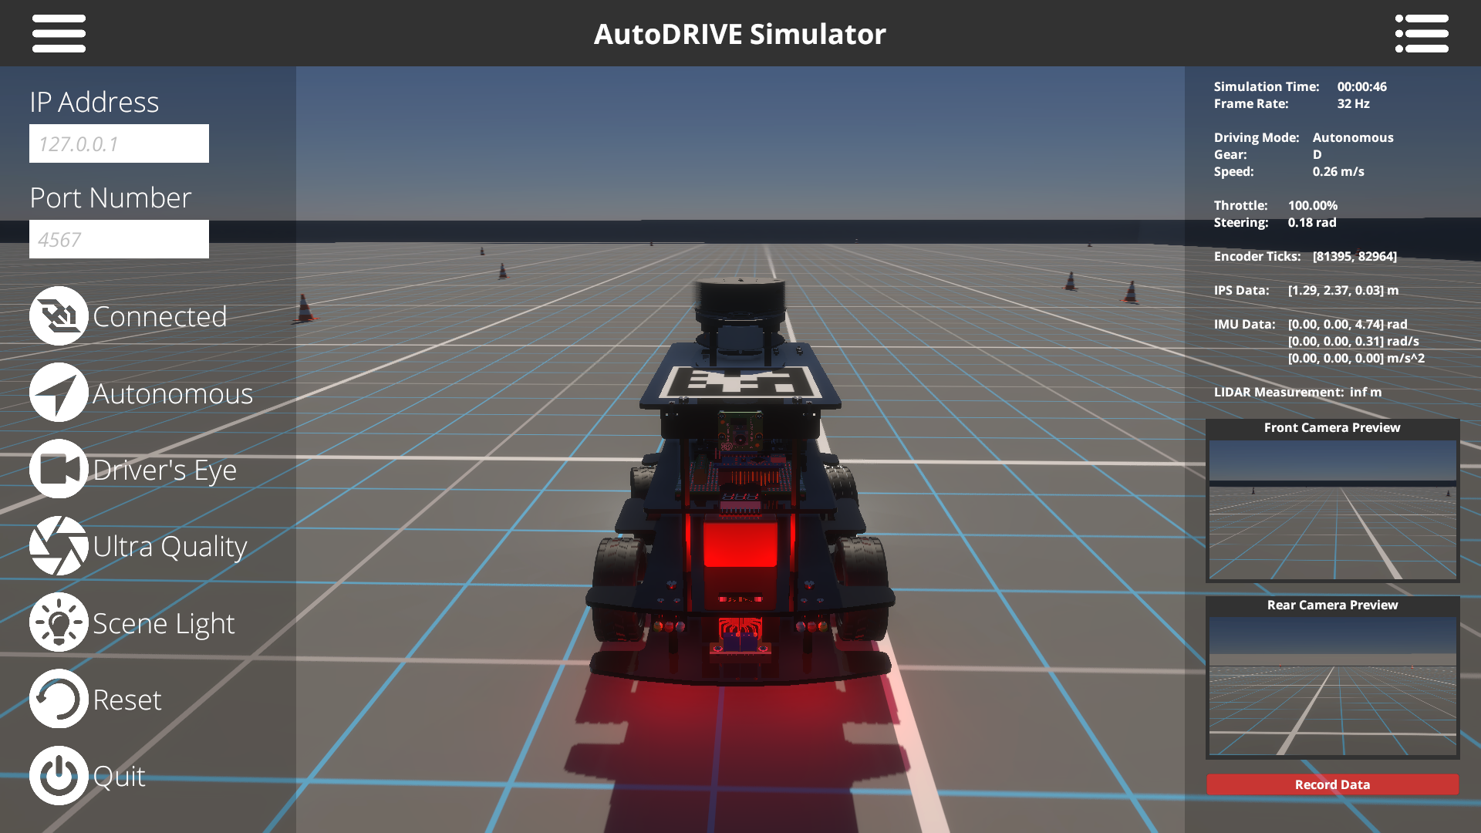
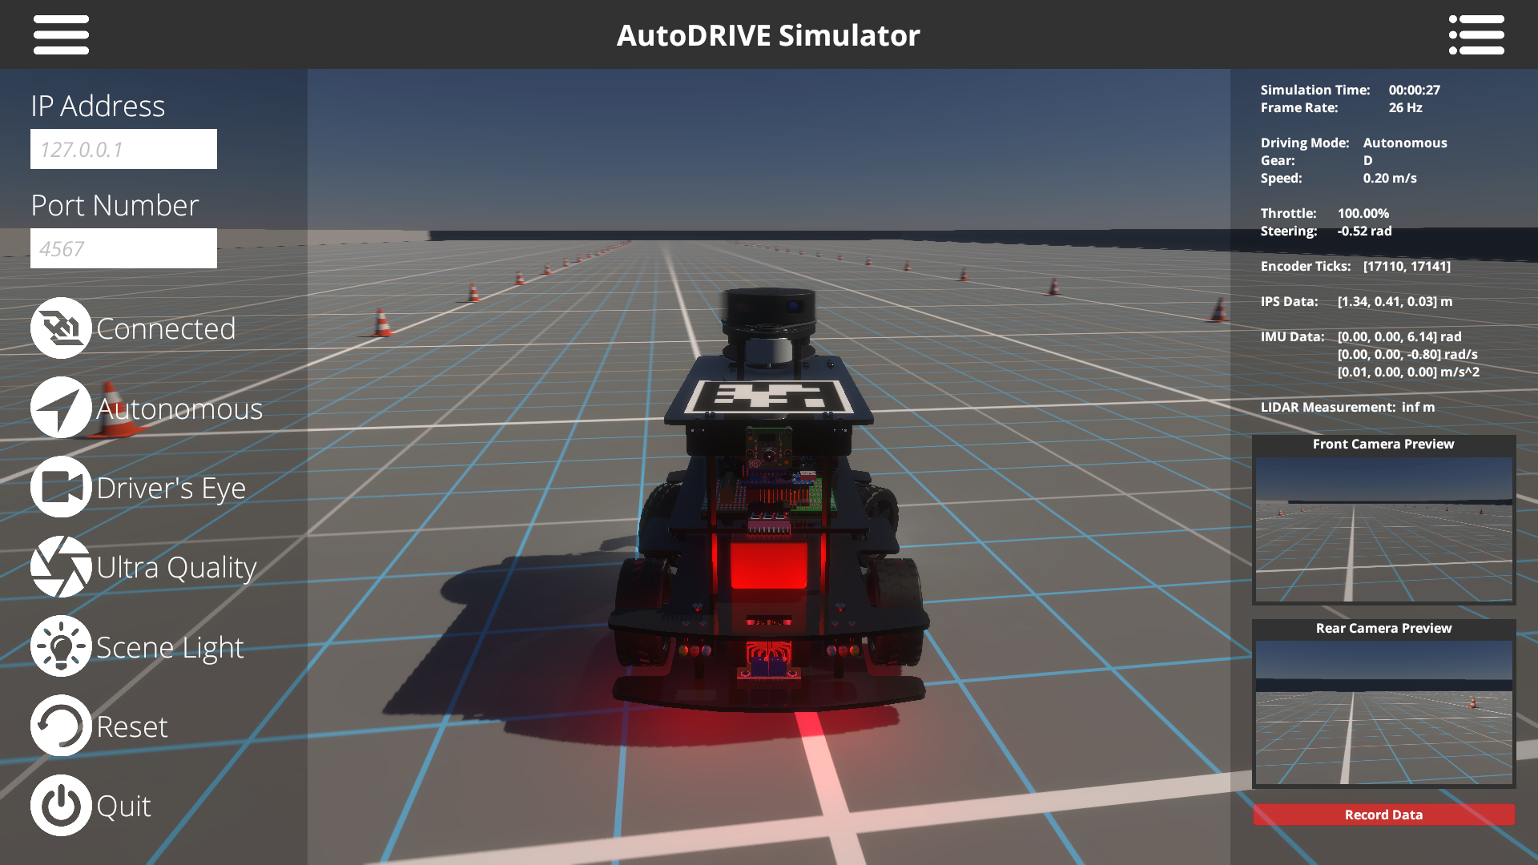
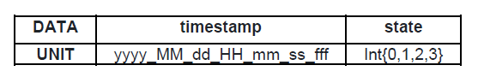
Data Collection
AutoDRIVE Simulator
Nigel (1:14) Vehicle
Dynamics + perception
Automated script
Dataset: https://github.com/Tinker-Twins/AutoDRIVE-Nigel-Dataset

Slide 15
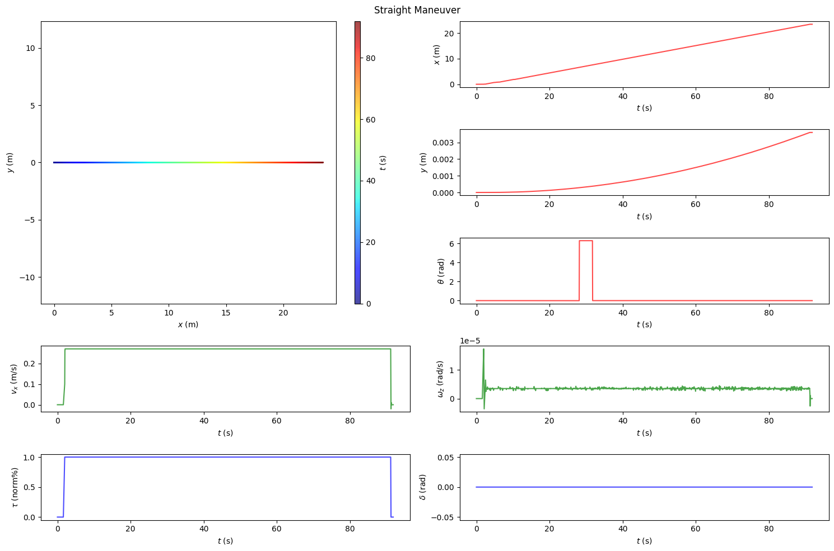
Data Collection
Straight
Skidpad
Fishhook
Slalom
Eight

Slide 16
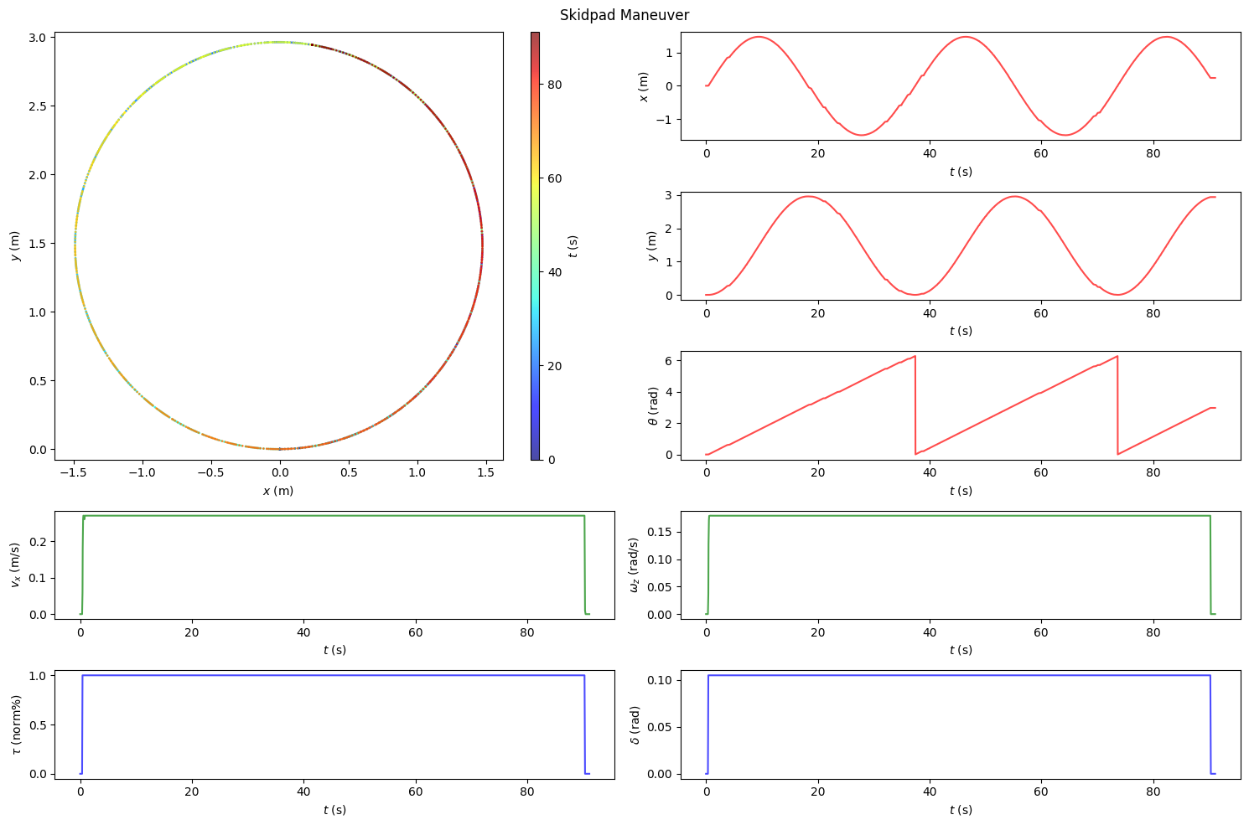
Data Collection
Straight
Skidpad
Fishhook
Slalom
Eight

Slide 17
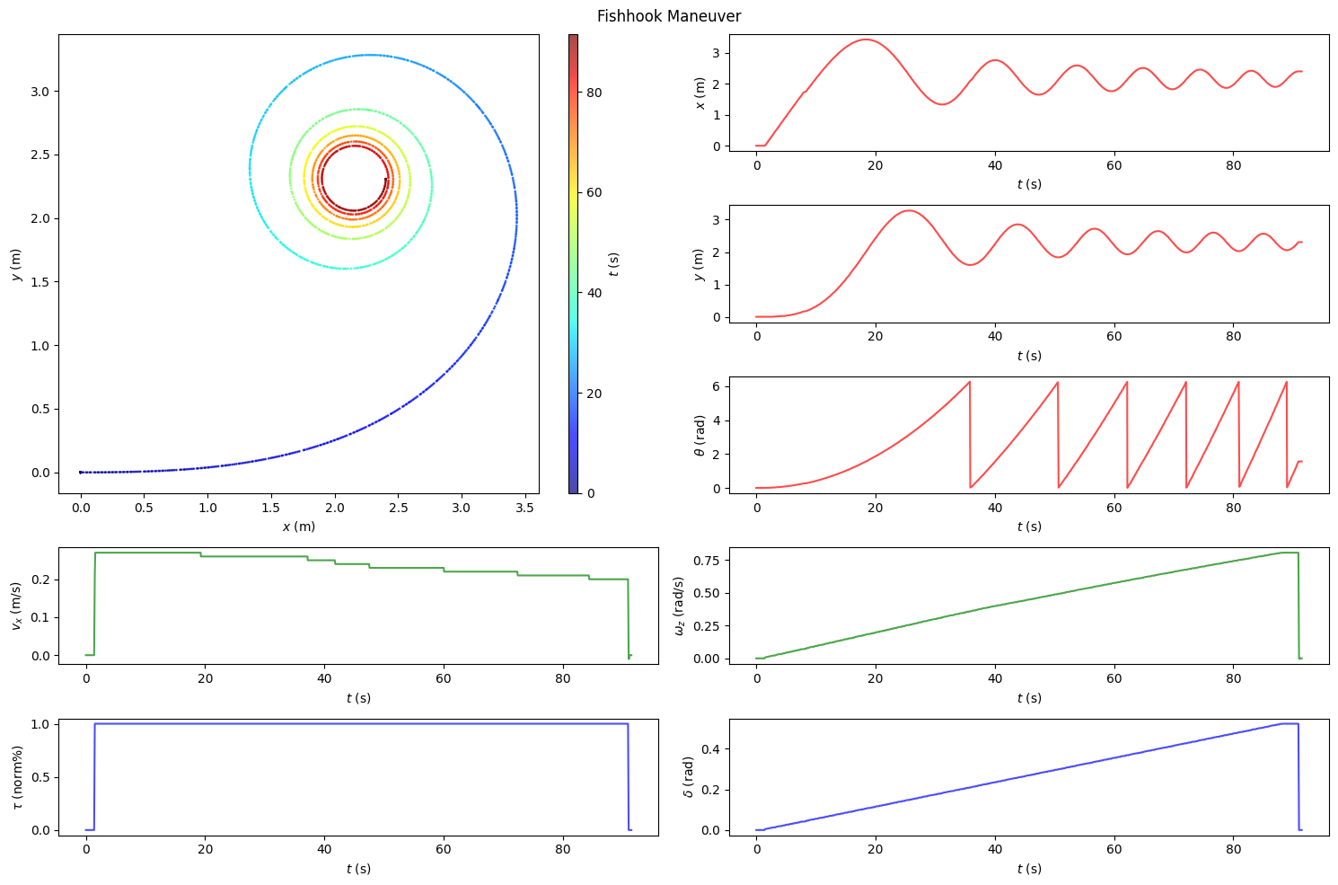
Data Collection
Straight
Skidpad
Fishhook
Slalom
Eight

Slide 18
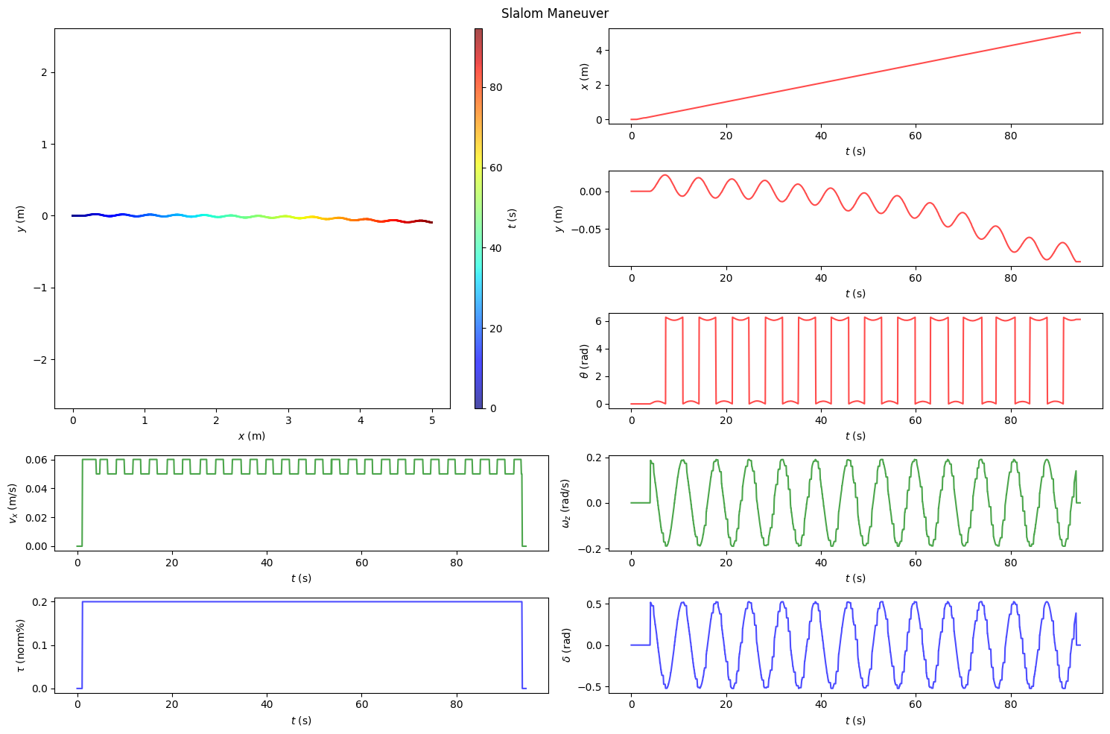
Data Collection
Straight
Skidpad
Fishhook
Slalom
Eight

Slide 19
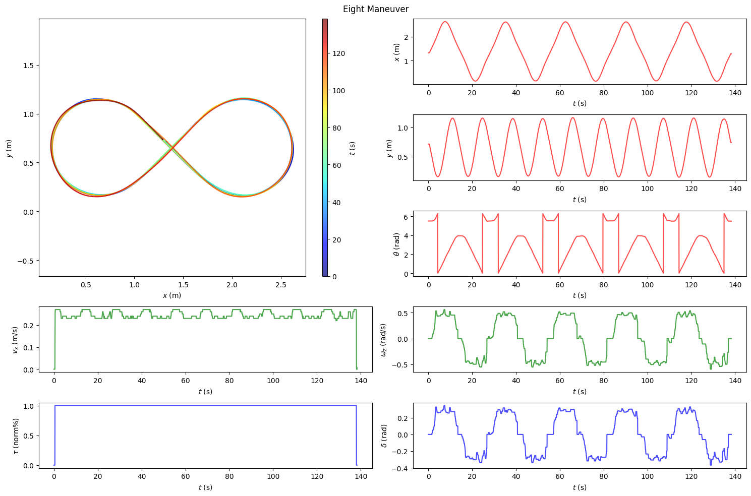
Data Collection
Straight
Skidpad
Fishhook
Slalom
Eight

Slide 20
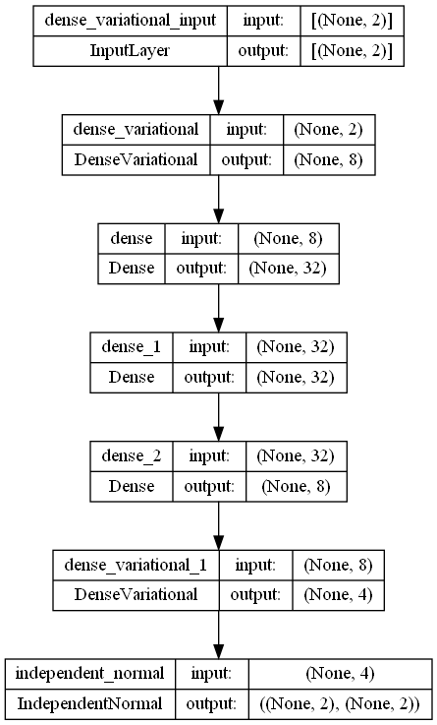
Hyperparameter Tuning
# epochs: {5, 10, 15, 20, 25, 30}
# hidden layers: {3d, 2v, 3v, 5v, 3d2v}
Learning rate: {5e-3, 1e-3, 1e-2, 1e-1}
Activation functions:
Bounded: {tanh, sigmoid}
Unbounded: {elu, relu, selu, softplus}
Optimizer: {SGD, RMSprop, Adam}
Loss function: {NLL, MSE, MAE}
Prior distribution: {univariate Gaussian, multivariate Gaussian}
Posterior distribution: {univariate Gaussian, multivariate Gaussian}
KL-divergence: {approx, exact}

Slide 21
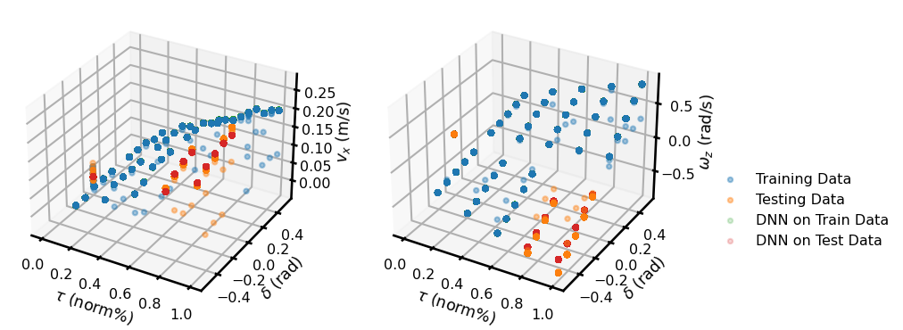
Hyperparameter Tuning
# epochs: {5, 10, 15, 20, 25, 30}
# hidden layers: {3d, 2v, 3v, 5v, 3d2v}
Learning rate: {5e-3, 1e-3, 1e-2, 1e-1}
Activation functions:
Bounded: {tanh, sigmoid}
Unbounded: {elu, relu, selu, softplus}
Optimizer: {SGD, RMSprop, Adam}
Loss function: {NLL, MSE, MAE}
Prior distribution: {univariate Gaussian, multivariate Gaussian}
Posterior distribution: {univariate Gaussian, multivariate Gaussian}
KL-divergence: {approx, exact}
Skidpad {5, 1e-3, 3d, relu, Adam, MSE}

Slide 22
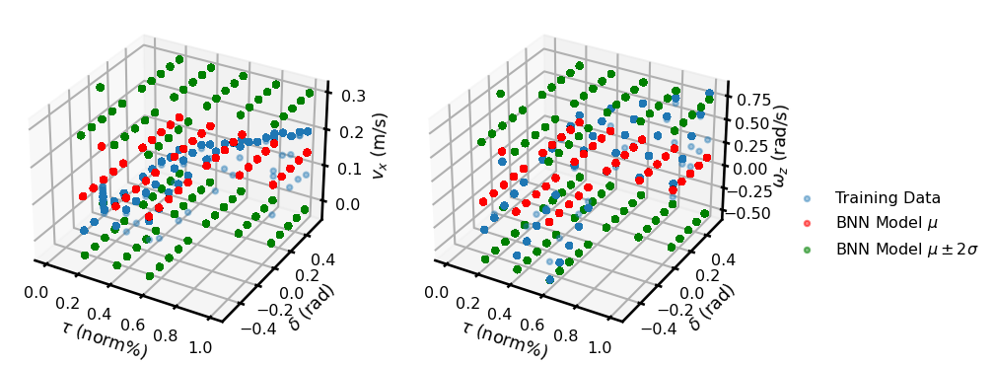
Hyperparameter Tuning
# epochs: {5, 10, 15, 20, 25, 30}
# hidden layers: {3d, 2v, 3v, 5v, 3d2v}
Learning rate: {5e-3, 1e-3, 1e-2, 1e-1}
Activation functions:
Bounded: {tanh, sigmoid}
Unbounded: {elu, relu, selu, softplus}
Optimizer: {SGD, RMSprop, Adam}
Loss function: {NLL, MSE, MAE}
Prior distribution: {univariate Gaussian, multivariate Gaussian}
Posterior distribution: {univariate Gaussian, multivariate Gaussian}
KL-divergence: {approx, exact}
Skidpad {10, 1e-3, 3v, sigmoid, Adam, NLL, MVG, approx KLD}

Slide 23
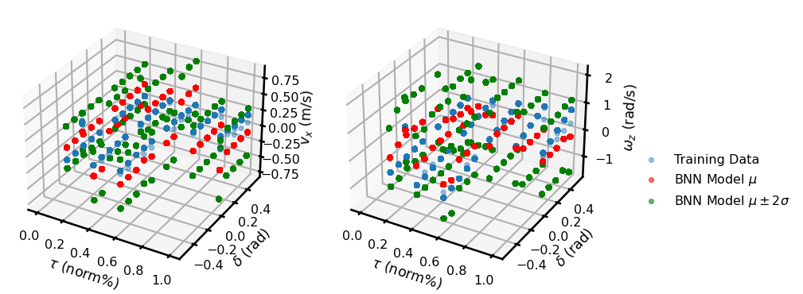
Hyperparameter Tuning
# epochs: {5, 10, 15, 20, 25, 30}
# hidden layers: {3d, 2v, 3v, 5v, 3d2v}
Learning rate: {5e-3, 1e-3, 1e-2, 1e-1}
Activation functions:
Bounded: {tanh, sigmoid}
Unbounded: {elu, relu, selu, softplus}
Optimizer: {SGD, RMSprop, Adam}
Loss function: {NLL, MSE, MAE}
Prior distribution: {univariate Gaussian, multivariate Gaussian}
Posterior distribution: {univariate Gaussian, multivariate Gaussian}
KL-divergence: {approx, exact}
Skidpad {25, 5e-3, 2v, tanh, RMSProp, NLL, MVG, approx KLD}

Slide 24
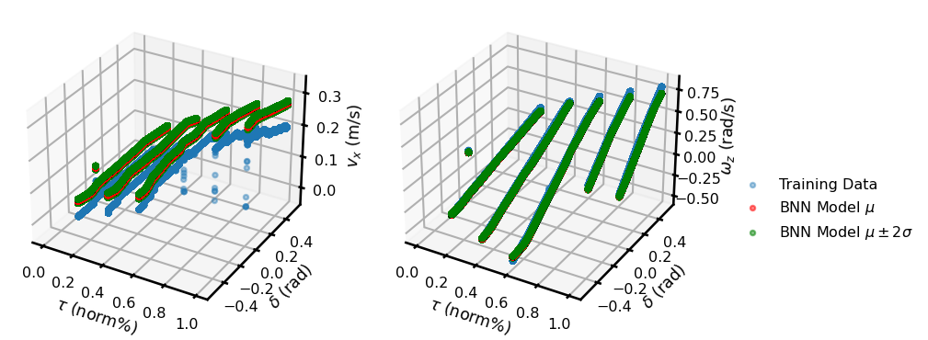
Hyperparameter Tuning
# epochs: {5, 10, 15, 20, 25, 30}
# hidden layers: {3d, 2v, 3v, 5v, 3d2v}
Learning rate: {5e-3, 1e-3, 1e-2, 1e-1}
Activation functions:
Bounded: {tanh, sigmoid}
Unbounded: {elu, relu, selu, softplus}
Optimizer: {SGD, RMSprop, Adam}
Loss function: {NLL, MSE, MAE}
Prior distribution: {univariate Gaussian, multivariate Gaussian}
Posterior distribution: {univariate Gaussian, multivariate Gaussian}
KL-divergence: {approx, exact}
Fishhook {25, 1e-3, 3d2v, sigmoid, RMSProp, MAE, MVG, approx KLD}

Slide 25
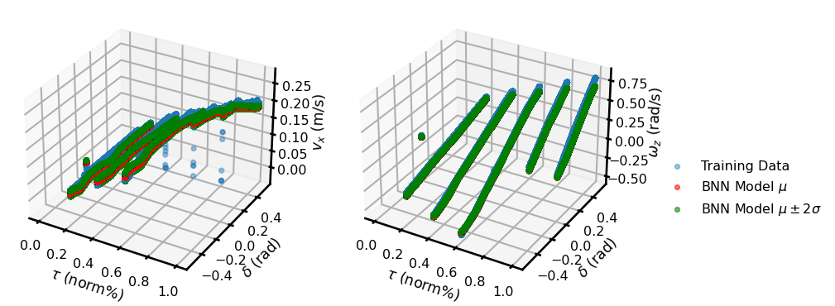
Hyperparameter Tuning
# epochs: {5, 10, 15, 20, 25, 30}
# hidden layers: {3d, 2v, 3v, 5v, 3d2v}
Learning rate: {5e-3, 1e-3, 1e-2, 1e-1}
Activation functions:
Bounded: {tanh, sigmoid}
Unbounded: {elu, relu, selu, softplus}
Optimizer: {SGD, RMSprop, Adam}
Loss function: {NLL, MSE, MAE}
Prior distribution: {univariate Gaussian, multivariate Gaussian}
Posterior distribution: {univariate Gaussian, multivariate Gaussian}
KL-divergence: {approx, exact}
Fishhook {25, 1e-3, 3d2v, sigmoid, Adam, MAE, MVG, exact KLD}

Slide 26
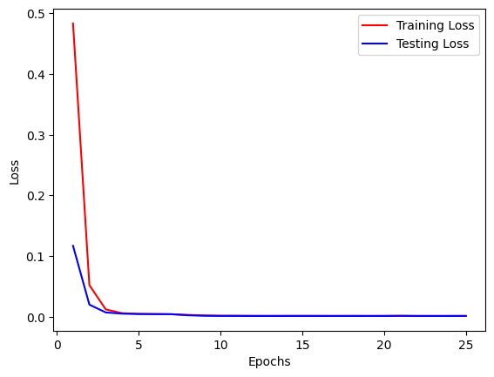
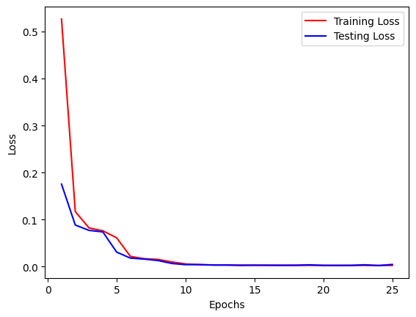
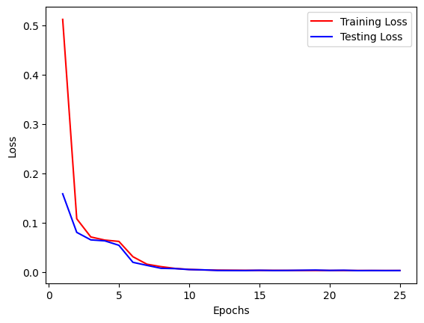
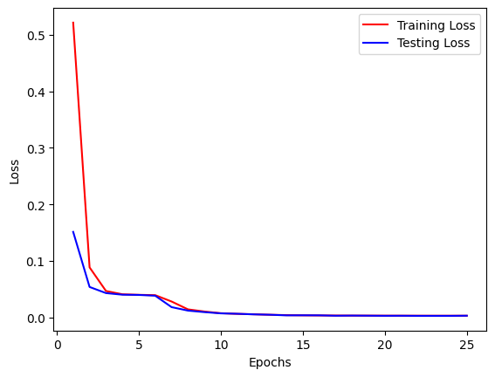
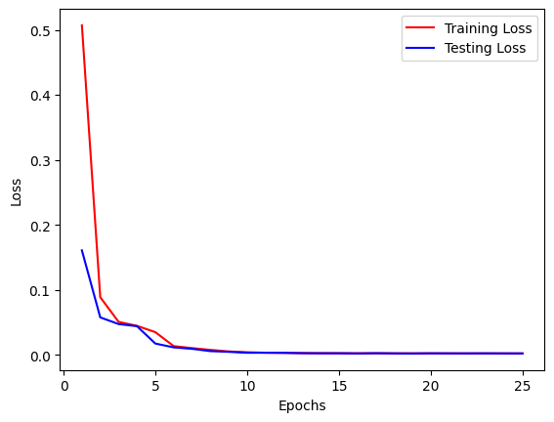

Model Training
Straight Maneuver
Skidpad Maneuver
Fishhook Maneuver
Slalom Maneuver
Eight Maneuver
All Maneuvers

Slide 27




Model Inference – Straight Maneuver
Note: This work adheres to Markov assumption.

Slide 28




Model Inference – Skidpad Maneuver
Note: This work adheres to Markov assumption.

Slide 29




Model Inference – Fishhook Maneuver
Note: This work adheres to Markov assumption.

Slide 30




Model Inference – Slalom Maneuver
Note: This work adheres to Markov assumption.

Slide 31




Model Inference – Eight Maneuver
Note: This work adheres to Markov assumption.

Slide 32




Model Inference – Generalization Across All Maneuvers
Note: This work adheres to Markov assumption.

Slide 33
Future Plans
Formulate and implement probabilistic Bayesian LSTM (delayed embedding)
Try different input representation technique (e.g. timeseries snapshot of state information)
Utilize other state (and perception) information from dataset
Transfer learning for expanding model’s ODD to different operating points
Ensemble models for different operating points
Simulation + real-world vehicle data (across scales)
Active sampling to collect (sample) new data points smartly based on epistemic uncertainty

Slide 34
Thank You!
Open to questions and suggestions…

